Slide 1
Lab Notebooks for Computational Mathematics, Sciences, & Engineering One ex-experimentalist’s perspective
Jared O’Neal
(he/him)
Argonne National Laboratory
Software Productivity and Sustainability track @ Argonne Training Program on Extreme-Scale Computing summer school
Contributors: Jared O’Neal (ANL)
Thanks to: Akash Dhruv, Anshu Dubey, Steve Fickas, Carlo Graziani, Tom Klosterman, & Boyana Norris
Notes:
This talk was designed for 45 minutes
This is a journey because we ramp up from fundamental, high-level concepts, through documentation to a concrete example of documentation. Anshu and I have designed this talk and the talk on lab environments that follows it so that one is the extension of the other. The second acknowledges that lab notebooks don’t exist as a single entity but must be baked into a larger lab env. Anshu caps it all off by discussing how to use a lab env in the larger scale of a research campaign. In this case, we have structured the journey as a long, sustained bottom-up crescendo toward discussing the importance of scientific rigor in computational sciences in a way that will hopefully be immediately relatable to the audience’s life. Hopefully, this will help them appreciate retroactively the mundane low-level details discussed earlier.
This talk has grown from many interesting conversations that I have had with a variety of different computational sciences. This includes different disciplines and different experience levels. When I have these conversations, all parties generally tend to learn something. This module will continue along those lines. I am not here to convince anyone of anything. I am not here to preach. I am just here to present a novel experience.
If you look at the content of this slidedeck alone, the content fizzles out. In particular, it just raises questions at the end. Therefore, it should be stated up front that
There is no single format for a lab notebook. It will depend on each user, on a team, on a project. Also, the tools and needs will change with time. Therefore, this is not a talk designed to inform or instruct. It is a discussion and its intent is to get people thinking.
That this journey doesn’t end with this talk. It flows into the next talk.

Slide 2

License, Citation and Acknowledgements
License and Citation
This work is licensed under a Creative Commons Attribution 4.0 International License (CC BY 4.0).
The requested citation the overall tutorial is: David E. Bernholdt, Anshu Dubey, Todd Gamblin, Jared O’Neal, and Boyana R. Norris, Software Productivity and Sustainability track, in Argonne Training Program on Extreme-Scale Computing, St. Charles, Illinois, 2022. DOI: 10.6084/m9.figshare.20416215.
Individual modules may be cited as Speaker, Module Title, in Better Scientific Software tutorial, ISC, 2022 …
Acknowledgements
This work was supported by the U.S. Department of Energy Office of Science, Office of Advanced Scientific Computing Research (ASCR), and by the Exascale Computing Project (17-SC-20-SC), a collaborative effort of the U.S. Department of Energy Office of Science and the National Nuclear Security Administration.
This work was performed in part at the Argonne National Laboratory, which is managed by UChicago Argonne, LLC for the U.S. Department of Energy under Contract No. DE-AC02-06CH11357.
This work was performed in part at the Lawrence Livermore National Laboratory, which is managed by Lawrence Livermore National Security, LLC for the U.S. Department of Energy under Contract No. DE-AC52-07NA27344.
This work was performed in part at the Los Alamos National Laboratory, which is managed by Triad National Security, LLC for the U.S. Department of Energy under Contract No.89233218CNA000001
This work was performed in part at the Oak Ridge National Laboratory, which is managed by UT-Battelle, LLC for the U.S. Department of Energy under Contract No. DE-AC05-00OR22725.
This work was performed in part at Sandia National Laboratories. Sandia National Laboratories is a multi-mission laboratory managed and operated by National Technology and Engineering Solutions of Sandia, LLC., a wholly owned subsidiary of Honeywell International, Inc., for the U.S. Department of Energy’s National Nuclear Security Administration under contract DE-NA0003525.
This work was performed in part at University of Oregon through a subcontract with Argonne National Laboratory.

Slide 3
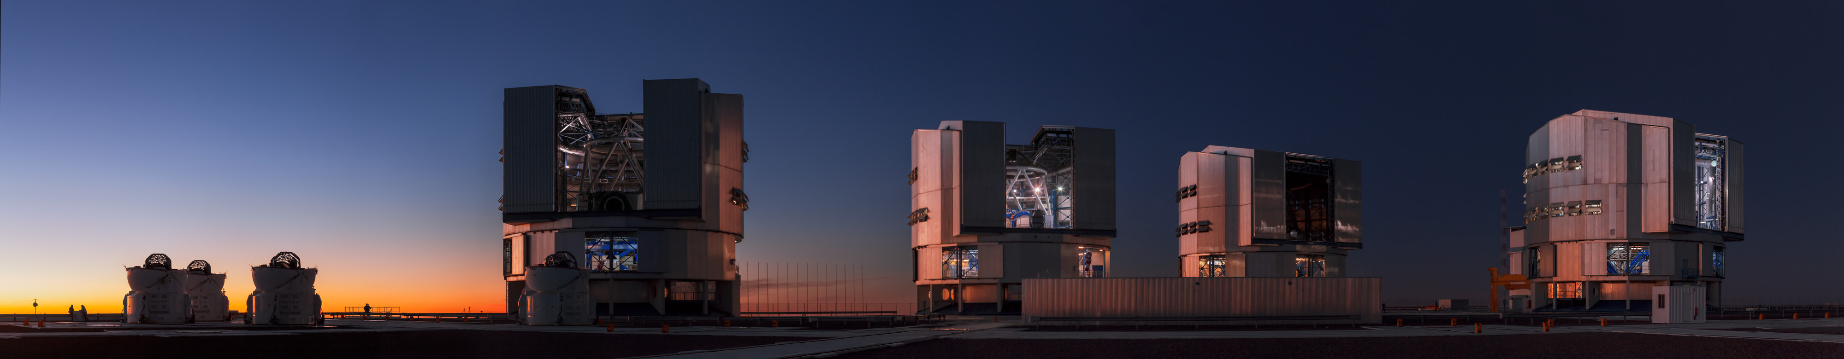
My background
Credit: ESO/B. Tafreshi (twanight.org)
Experimental condensed matter physics background
Low-energy positron diffraction
Low-temperature, ultra-high-vacuum scanning tunneling microscopy
Professional experience in observational science environment
European Southern Observatory’s Paranal Observatory
Instrumentation & systems engineer specialized in adaptive optics
Scientific software developer
Primarily focused on applications
Always working on scientific instrumentation
Notes:
Emphasize that implicit in this is my belief that developing scientific software is developing a scientific instrument – not just analogous
This slide should give them context for understanding my point of view.
Physics was mostly about designing, constructing, all aspects of scientific data including data analysis.
* Observatory was working to ensure high-quality results with full context so that public can do science
While my experimental background was closer to R&D, the observatory work was clearly more about operations - Paranal is a science factory. This is different in some ways, very rigorous, and at a very large scale. To adapt ideas/tips/tricks/tools for observatory, there needs to be some simplification.
Part of working on scientific instrumentation is understanding how the data is generated and therefore understanding how to correctly and rigorously analyze data and draw conclusions from data.

Slide 4
Why discuss experimental sciences at ATPESC?
Scientific HPC is several young fields that “on close examination, have not really stabilized or optimized their collaborative processes in a manner analogous to that of more mature, ‘classical’ sciences. As a consequence, valuable science is often needlessly lost, or left uncollected.”
- Carlo Graziani, Computational Scientist at ANL, HPC and the Lab Manager
“… practicing the scientific method properly requires good software practices. This is understood in the experimental community…The computational science side has had a historic problem with it. As we can see, it’s getting better.”
- Katherine Riley, Director of Science at ALCF, ATPESC 2019
Notes:
Emphasize that Katherine’s quote has three main points, each of which resonates with me.
low-level science practices are required to do rigorous, reproducible science
Experimentalists do understand this
Computational science not so much
What does she mean by software practices
Design and implement software following best practices
Test your code
Use version control and use it well
Code reviews
Documentation (e.g., document your assumptions)
Many people refer to software practices as “software engineering”. I whole-heartedly disagree with this. I understand this work to be foundational, bedrock science that is required to do high-quality trustworthy high-level science. The people in charge of the high-level science need to control & own the low-level science because they know what is needed to do good research. But, we need not reinvent the wheel. We can learn from the SW Eng community and adapt what they know and use.

Slide 5
A minimal definition
A goal of keeping a lab notebook is "...to write with enough detail and clarity that another scientist could pick up the notebook at some time in the future, repeat the work based on the written descriptions, and make the same observations that were originally recorded. If this guideline is followed, even the original author will be able to understand the notes when looking back on them after considerable time has passed!”
- Howard Kanare, Writing the Laboratory Notebook
Notes:
Module designed with the expectation that attendees have a basic idea of what a lab notebook is as well as some experience (e.g., in university lab classes).
This is just a moment to confirm this and understand the bare minimum of what a lab notebook should do. Put this up front so that people can relate slides to what they understand of lab notes.
Emphasize that this is mostly likely the base minimum. In this sense, the notebook is like a cookbook with a collection of recipes we want others to execute.

Slide 6
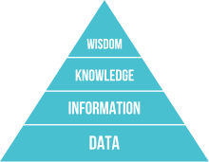
DIKUW
Data, Information, Knowledge, Understanding, Wisdom
A classification scheme that overloads every day words so that we can use the same language and understand each other.
We will build on this to understand & appreciate
documentation & lab notebooks.
DIKW pyramid (unaltered) – Wikipedia/Longlivetheux
Notes:
Point out that if they search for this, they will find many pages. Those pages have changed over time – it used to be DIKUW, now it’s the DIKW pyramid. I don’t know much beyond this classification, but find the classification to be quite useful and don’t know why they exclude understanding now. I present my understanding and what I see as useful for the following discussion.
We won’t be defining these terms exactly as that is likely quite hard. We will go through examples to gain an intuitive understanding of these concepts.

Slide 7
Data & Information
Data
Collection of numbers, symbols, text, etc.
It has value only because it was recorded and exists.
Example: Timeseries representation of temperature, relative humidity, and precipitation.
Information
Facts gleaned from data.
Answers questions such as who, what, when, how much, how long, etc.
Example: Starting at 2pm the temperature dropped by 5ºF over 15 minutes. At 2:05 pm it started to rain and 0.25” of rain was accumulated over the next 30 minutes.
Notes:
My understanding is that data is *not* facts, as some claim. Rather, data can be flawed and noisy. Information is facts that are true relative to the potentially flawed data.
Data is valuable because it helps us make decisions.
Information is data made (hopefully) useful.

Slide 8
Knowledge & Understanding
Knowledge
Derived from information, experience, and understanding.
Example: When relative humidity levels are high and the temperature drops substantially, there is an increased probability of precipitation.
Understanding
A deep theoretical background in and practical experience with the system whose data was acquired and studied?
The ability to explain why?
“Understanding is a kind of ecstasy” – Carl Sagan
Example: A meteorologist could explain at different levels of detail how the atmosphere works to substantiate the knowledge.
You can share knowledge, can you share understanding?
Notes:
Knowledge is generated by a process in such a way that it is an educated best guess. But, it should be a solid and justifiable educated guess. In this sense, it is not true but our best current guess at what is true.
I didn’t use the given timeseries information to derive this knowledge. Someone with understanding of meteorology did. They have a deep understanding derived from years of study and experience. However, that person presented and communicated the knowledge for consumption by those without understanding.
If a person doesn’t have understanding they can speculate at what the knowledge should be. Hopefully having understanding can elevate the statement from speculation to knowledge because understanding can substantiate at a level required by other experts.
It’s hard to define understanding. I have just written down my best guesses.
When you go to school, are your teachers and professors putting understanding in your head or do they share knowledge and create an environment in which one can generate understanding?
Understanding is built on the shoulders of giants. You read an article that helps you generate understanding. But the author of that article generated it from understanding he or she developed from taking classes with other

Slide 9
Obligatory Einstein quote
“Any fool can know. The point is to understand.”
- Albert Einstein
Is understanding always the ultimate goal?
Are there times when mere knowledge is sufficient?
I don’t need to understand atmospheric science or weather prediction. I just need basic knowledge to determine if I should take an umbrella with me.
Notes:
One extreme is trying to understand all aspects of the work that we do. Is that feasible or even achievable?
The other extreme is in choosing how we use the internet:
When you read the internet are you gaining knowledge of understanding? Is it possible to build understanding by only accessing bits of knowledge scattered across the internet? I believe that Elaine’s work would say no. You need someone with understanding to collect knowledge sources across the internet, organize these, and present them in such a way that the novice can generate understanding.
A different, modern way to approach this same question:
If an ML/DL code had generated the knowledge given in the example but in such a way that interpretability is low, are we OK with inexpressible or inaccessible understanding?

Slide 10
Sometimes we just want “good enough”
Not every developer needs to be an expert in git
We want the people designing the rules of how we use and interact through git to have understanding so that collaborating via git requires minimal git knowledge
git workflow should protect code so that we can’t do damage
Focus on the development/testing and not on git
Low barrier for newcomers
Notes:
This can explain some of the difficulties that occur when a git expert is forced to use a workflow designed for a team with only git knowledge. They aren’t allowed to work in a more powerful, efficient, and effective way. If they do work in their powerful way, they can upset all those with insufficient understanding.

Slide 11
Knowledge Management
DIKUW is related to knowledge management
We want to
Recognize when we generate knowledge
Capture and preserve that knowledge
Communicate that knowledge
Scientific work can benefit from knowledge management
Is knowledge communication only about communicating to others?
Notes:
Really most any project benefits from putting some thought into knowledge management.
The key is first to recognize when knowledge is generated. Once I became aware of this classification and began to think in terms of it, it became easier for me to recognize knowledge generation. It’s as if a bell goes off in my brain that indicates we need to record what was just said.
The answer to the question is ”clearly no”, We need to communicate to our future selves for the sake of productivity and reproducible research. Refer back to minimal definition of lab notebooks.

Slide 12
Example: Lessons learned
After we live through an experience we want to derive lessons learned
Experience is valuable, more so if we reflect and are thoughtful
Generate/capture knowledge to grow, improve, and avoid difficulties/mistakes
Hope to improve understanding
We get more if we derive lessons learned together
Create more or higher quality knowledge
Communicate the knowledge implicitly
Should we communicate lessons learned to others?
Notes:
The point of this slide is to map the high-level, abstract concepts (which some might not like) onto a concrete example that we know & understand.
I believe that this is also known as debriefing.

Slide 13
Which leads us to documentation
Documentation is knowledge communication & can build understanding
Data at the bottom. Knowledge as we move up?
Some documents frozen at creation. Others are living.
Does this capture how hard it is to do documentation in a distributed, digital world?
Notes:
Documentation is capture, preserve, & communicate
Not all documents are alike.

Slide 14
And finally we reach our destination
Lab notebooks are
A fundamental part of communication as well as rigorous, reproducible science in a lab,
A common-place or required part of an experimental laboratory,
Populating a scientific “lab notebook” was an “automated” process at the observatory,
A tool for preventing scientific fraud, and
Record of invention and defending against allegations of fraud.
Lab notebooks
Should be used regularly,
Should be comprehensive and never filtered,
Don’t need perfect grammar and full sentences,
Content is frozen at creation, and
Hopefully contains more than just data (e.g., motivation, reasoning, conclusions).
They aren’t good at communicating knowledge, but
people interact, evolve, and grow by collaborating through the notebook.
Notes:
Automated is in quotes because the TIOs and astronomers still needed to input information into a system. But there was a process for them to input such data into tools that aggregated their input with other notes.
Relate back to minimal lab notebook definition. We want more that just a cookbook.
Notebooks serve as implicit communication

Slide 15
Example notebook entries
A better example
Monday July 25, 2022 (Jared)
9:05 am - Continuing work for study ABC. (See July 7)
- I presently believe that if A happens, then B must also happen.
- To verify this, I intend to
…
***
9:30 am - Started executing this experiment on Bebop.
Built debug version of binary with Intel 20.4
Based on clean commit 5a43b21c
Build log saved to my_test_2022.log
No errors or warnings emitted
Used job script run_my_test with configuration 24 (Job ID 123456)
Stdout/err & results saved in folder ABC
10:07 am - Analysis run with script analyze_my_test.py and results saved in same folder.
- Since no peak seen around 1.5 MeV, I was wrong. But based on this, I now believe that if A happens, then C must also happen.
A bad example
Monday July 25, 2022
9:05 am - Do study ABC
8:47 pm - Lot’s of interesting data!
- Results are in GCE
Notes:
Bad example is not at all comprehensive. Imagine if we have three different researchers acquiring data and taking no notes or just these notes. How can you stitch the whole data set together at the time much less at a later time?
Doesn’t need to be exhaustive. I can just leave myself some bread crumbs with the expectation that writing notes is easier, but recreating notes could be time consuming should I ever need to do so.
Are the bread crumbs enough? Can they determine what flags are implied by debug version? What about the full SW stack? What about the SW stack for the analysis? Is such detail needed for this stage of work and if not, is that filtering?
Note that the build logs are acting as lab notes.
Note also, that we could have included git information in the build logs to make things simpler.
We likely should have included a graphic that points out missing peak. Annotating the graphic with what was expected would be nice.
The better example is also not great.

Slide 16
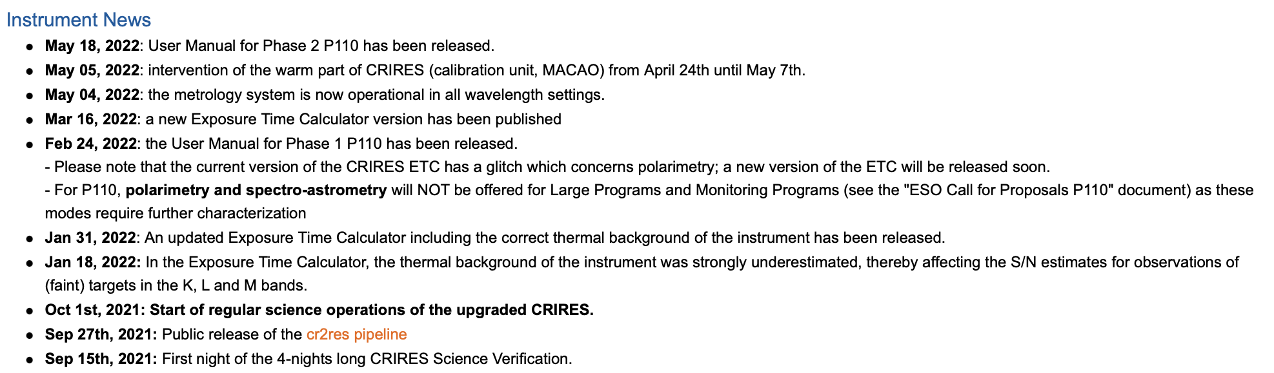
Not all lab notebooks are alike
Lab notebooks to record work done on instrument
Lab notebooks to record acquisition of data
Filtered lab notebook for users – higher up the hierarchy
From the CRIRES+ News (ESO) page
Hardware team
Data analysis team
Science team
Notes:
The filtered lab notebook is from the instrument CRIRES+. You have a team that has worked on the science verification and interfacing with public (user manual, tools), a team that works on data analysis pipelines (pipeline changes), a distributed team that works on the hardware. We can imagine that each team maintained a true lab notebook for their work. These were then filtered and merged for the consumption by public.
The filtering should not be too strong as one cannot know what details are necessary for all the public scientists to do their work.

Slide 17
No one likes writing lab notes…
We love to consume documentation; write it, not so much.
Optimistic
Lack of experience
Lack of training
Lack of appreciation
Lack of incentives
Cynical
We want and appreciate it when others share knowledge with us.
We don’t want to take the time to capture, preserve, and communicate knowledge we generate.
One aspect of productivity
One person decreases their short-term efficiency so that many (and the team) achieve long-term efficiency and quality.

Slide 18
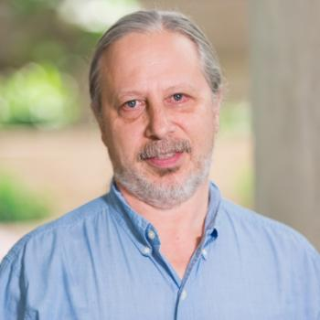
Conversations with Carlo
Carlo Graziani is a Computational Scientist at ANL
BSSW blog article HPC and the Lab Manager
My take away from the article and conversations
As researchers’ careers progress,
The problems become more complex and larger,
Previous informal techniques for executing a study start to fail,
The researchers sense that something is missing, and
They invent processes and tools to compensate.
This happened to Carlo and at some point he realized that
“I had re-invented the lab notebook!”

Slide 19
Tried-and-true
Nothing will ever beat good ol’ pen and paper
Most can use paper and pen in any situation
Open format can allow for creativity and easier annotation
Concentrate on the work rather than tooling
Quicker to scribble down notes than to use a digital tool
Good if notetaking slows down progress
Notebook is stored publicly next to where it is used
Notes:
The point is to start to understand what we want and what we don’t want. It’s also to understand some of the difficulties that we face.

Slide 20
No really. I’m not joking…
“Since at least the 1990s, articles on technology have predicted the imminent, widespread adoption of electronic laboratory notebooks (ELNs) by researchers. It has yet to happen — but more and more scientists are taking the plunge.”
- Roberta Kwok, How to pick an electronic laboratory notebook, Nature
Some must be purchased to access features and lift resource limits
Some include templates and collaboration tools
Tied to technology that could fail
Overwhelming variety of possible solutions with different pros and cons
Uncertainty about future of tool, increased costs, inability to export
Does funding restrict where and how digital notes can be stored?
Notes:
I, and I have seen others, end up jumping around, which might work if done well, but could make life harder.

Slide 21
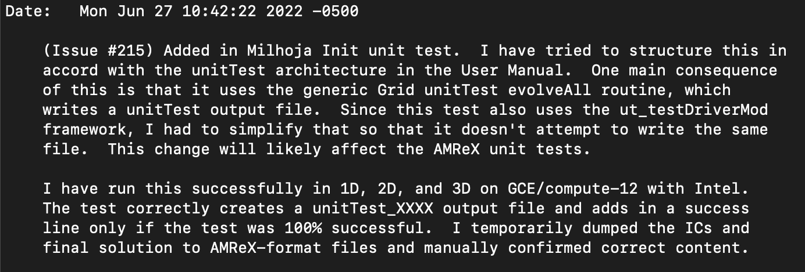
What would a lab notebook look like for us?
We work anywhere and sometimes in distributed way. Paper won’t work.
Should notebooks be public and how to do that?
How many different types of notebooks do we need?
Do we use a single ELN or distribute notes across a suite of tools?
How can we use automation appropriately to overcome difficulties and increase productivity?
Details not obvious from commit diff:
Motivation, reasoning, consequences
Testing notes
Notes:
AS WE GO, EMPHASIZE THAT WE WILL ATTEMPT TO ADDRESS DIFFERENT QUESTIONS IN NEXT TALK.
I no longer use pen & paper. I started trying to find a single tool and ended on Microsoft OneNote – low uncertainty, interface was closest to paper. In Nature article, others settled on OneNote as well. Now distribute across suite of tools. Go into that in next talk.
If we scatter notes across multiple tools, how do we and should we be able to combine them into something that looks like an actual lab notebook?
Long messages are not necessarily a bad commit message.
The git commit message is not just about recording changes. I want it to encapsulate the state of my brain a bit so that I can reload it into my brain if I need to study or revisit the commit. If I’m hunting for a bug, I want to know how I tested code to understand how a bug was undetected. These messages can also help me design a set of manual testing in the future. Therefore, this is as much of a communication to other developers as it is a communication to myself.
Rereading my commit messages as a first part of a code review helps me load the chronology and the big picture.
I assume that there are areas of computational science (e.g., nuclear science and engineering, simulations that aid in designing life critical systems such as planes) that use lab notebooks. Rather than search out differences, we need to search out similiarities when we talk with people from different disciplines and sub-disciplines. Ask them about the pain points related to doing low-level foundational science and how they try to overcome them. Yes, we are reinventing the wheel, but hopefully we can do so quickly and successfully by sharing with and learning from others.

Slide 22
Citations
Carlo Graziani, HPC and the Lab Manager. Better Scientific Software. https://bssw.io/blog_posts/hpc-and-the-lab-manager. Nov 17, 2021.
Katherine Riley, What All Codes Should Do: Best Practices. ATPESC 2019 presentation. Retrieved from YouTube. Nov 5, 2019.
Howard M. Kanare, Writing the Laboratory Notebook. American Chemical Society, Washington, D.C., 1985.
Roberta Kwok, How to pick an electronic laboratory notebook. Nature 560, pp. 269-270, Aug 6, 2018.
DIKW pyramid. 2022, August 4. In Wikipedia. https://en.wikipedia.org/wiki/DIKW_pyramid.

Slide 23
Meta conclusions
This module
Was not about sharing knowledge, but
Was about (hopefully) building understanding.
We established concepts, pros/cons, difficulties, & questions.
The next talk will address these in concrete way.

Slide 24
From my perspective
Software best practices are foundational science & are mandatory
Knowledge management can improve science & productivity
Productivity can arise from selflessness
Not all documents are alike
Not all lab notebooks are alike
Lab notebooks are mandatory
Lab notebooks allow for learning
Lab notebooks for CMSE are hard
To be continued…

